Slide 1
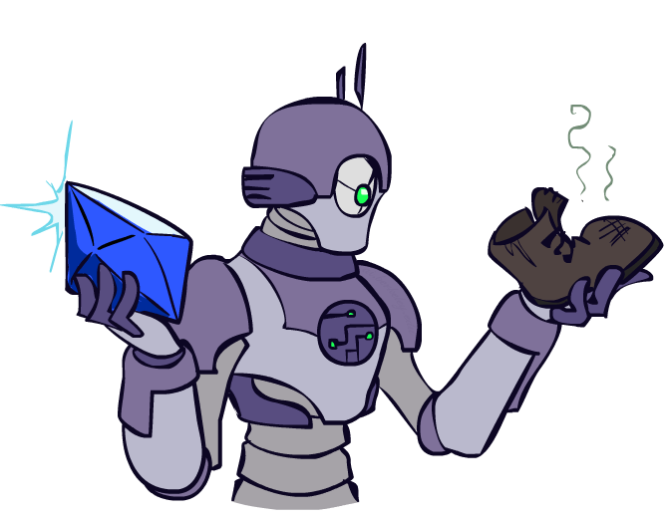

Today
Informed Search
Heuristics
Greedy Search
A* Search

Slide 2
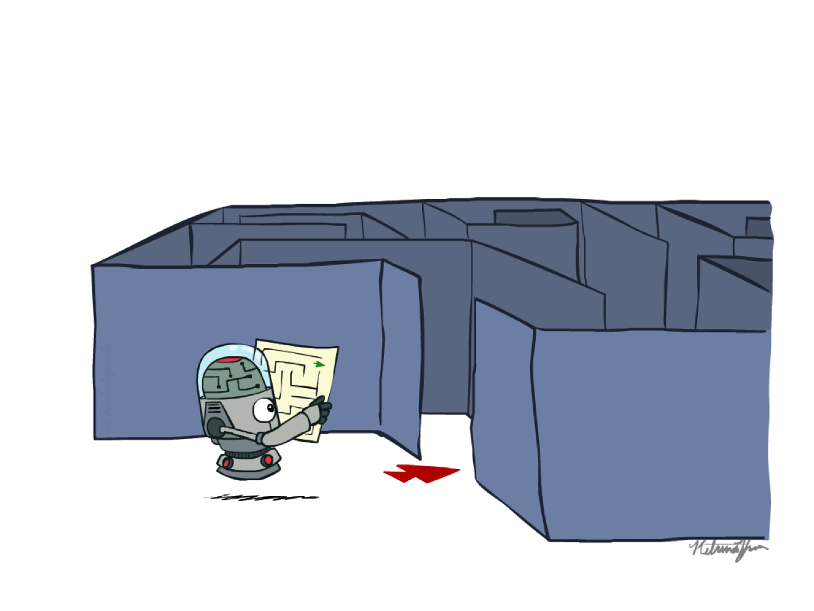
Recap: Search

Slide 3
Recap: Search
Search problem:
States (configurations of the world)
Actions and costs
Successor function (world dynamics)
Start state and goal test
Search tree:
Nodes: represent plans for reaching states
Plans have costs (sum of action costs)
Search algorithm:
Systematically builds a search tree
Chooses an ordering of the fringe (unexplored nodes)
Optimal: finds least-cost plans

Slide 4
Example: Pancake Problem
Cost: Number of pancakes flipped
Notes:
Gates, W. and Papadimitriou, C., "Bounds for Sorting by Prefix Reversal.", Discrete Mathematics. 27, 47-57, 1979.

Slide 5
Example: Pancake Problem
State space graph with costs as weights
4
2
3
2
3
4
3
4
2
3
2
2
4
3
Notes:
A* expanded 8100 ; Path cost = 33
UCS expanded 25263 . Path cost = 33
Greedy expanded 10 . Path cost = 41
[0, 7, 5, 3, 2, 1, 4, 6]
(7, 0, 5, 3, 2, 1, 4, 6)
(6, 4, 1, 2, 3, 5, 0, 7)
(3, 2, 1, 4, 6, 5, 0, 7)
(1, 2, 3, 4, 6, 5, 0, 7)
(5, 6, 4, 3, 2, 1, 0, 7)
(6, 5, 4, 3, 2, 1, 0, 7)
(0, 1, 2, 3, 4, 5, 6, 7)

Slide 6
General Tree Search
Action: flip top two Cost: 2
Action: flip all four Cost: 4
Path to reach goal:
Flip four, flip three
Total cost: 7
Notes:
You know exactly where you came from and how you got there, but you have no idea where you’re going. But, you’ll know it when you see it.

Slide 7
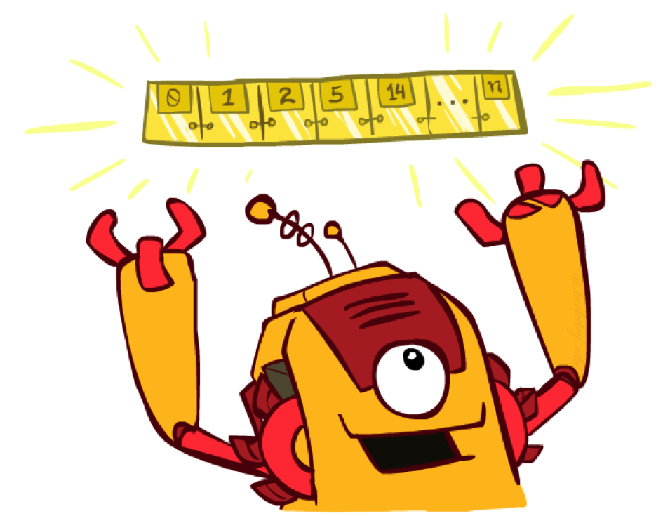
The One Queue
All these search algorithms are the same except for fringe strategies
Conceptually, all fringes are priority queues (i.e. collections of nodes with attached priorities)
Practically, for DFS and BFS, you can avoid the log(n) overhead from an actual priority queue, by using stacks and queues
Can even code one implementation that takes a variable queuing object

Slide 8
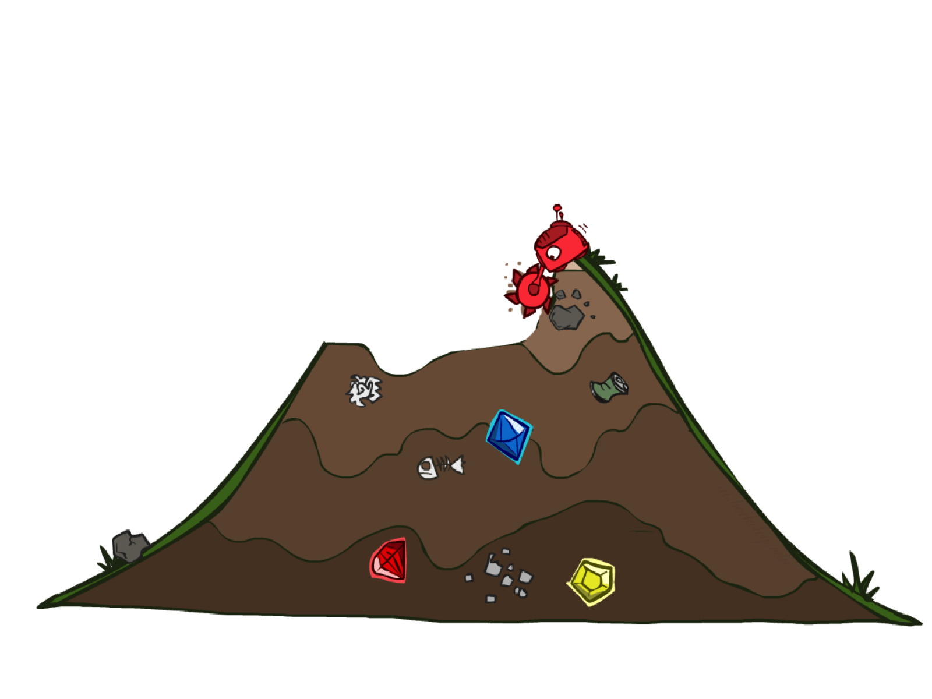
Uninformed Search

Slide 9
Uniform Cost Search
Strategy: expand lowest path cost
The good: UCS is complete and optimal!
The bad:
Explores options in every “direction”
No information about goal location
c ≤ 1
…
c ≤ 2
c ≤ 3
Start
Goal
[Demo: contours UCS empty (L3D1)]
[Demo: contours UCS pacman small maze (L3D3)]

Slide 10

Video of Demo Contours UCS Pacman Small Maze

